Slide 1

Churn Analysis

Slide 2
Introduction
Understanding and controlling customer churn has become essential for sustained growth and profitability in the competitive environment of modern enterprises.
Customer churn, also abbreviated to "churn," refers to the rate at which customers discontinue utilising a company's goods or services.
As recruiting new customers is often more expensive than keeping existing ones, it's a measure that can have a big impact on a company's bottom line.
Churn analysis is a data-driven strategy for bettering client retention and, eventually, corporate success. It aims to understand, measure, and address customer attrition.

Slide 3
Why is Churn Analysis Important?
Revenue Impact
Competitive Advantage
Customer Insights
Cost Efficiency
Predictive Capabilities

Slide 4
Data cleaning is a crucial step in churn analysis, as the quality of the data directly impacts the accuracy and effectiveness of the analysis. In this phase, you need to identify and address issues in the dataset that could lead to inaccuracies or bias in your results. Here are the typical data cleaning steps for churn analysis:
Handling Missing Values
Data Type Conversion
Removing Duplicates
Outlier Detection and Handling
Standardization and Scaling
Encoding Categorical Variables
Feature Selection
Handling Imbalanced Data
Checking Data Consistency
Data Transformation
Document Changes

Slide 5
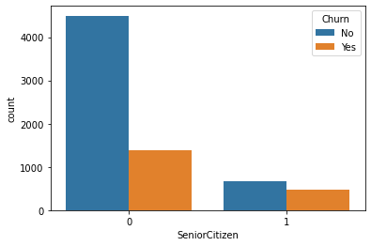
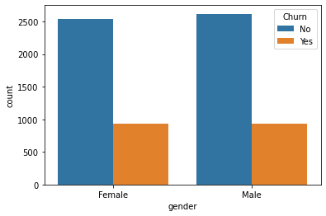
Univariate Analysis
Senior Citizen are more likely to churn
Female are more likely to churn

Slide 6
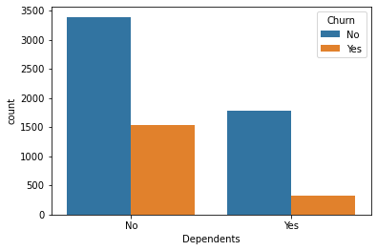
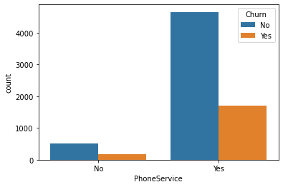
No Dependents are more likely to churn
No Phone Service are more likely to churn

Slide 7
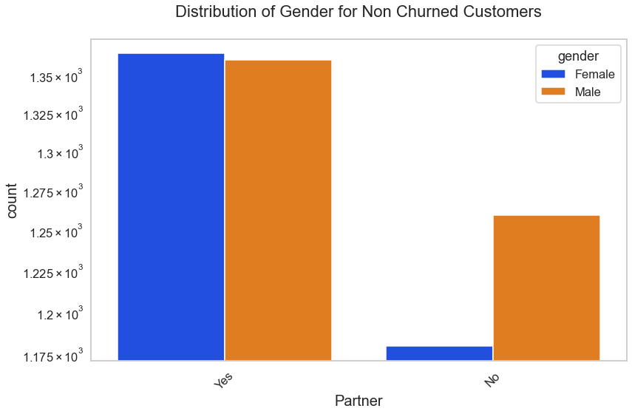
Bivariate Analysis
Gender does not seem to have a significant impact on customer churn. The distribution of gender among churned customers is relatively even.

Slide 8
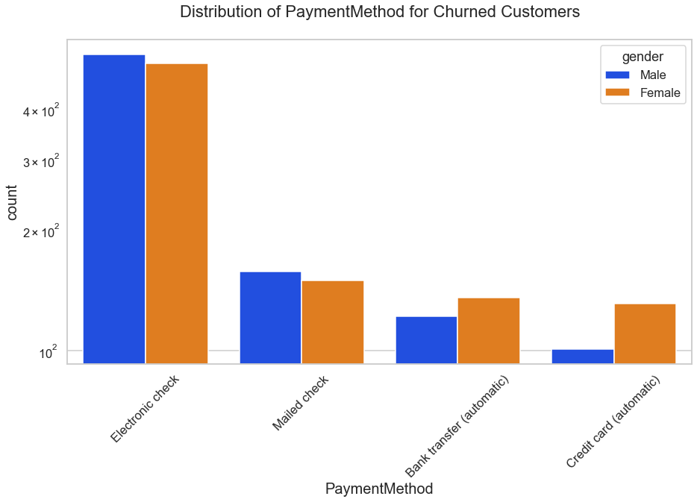
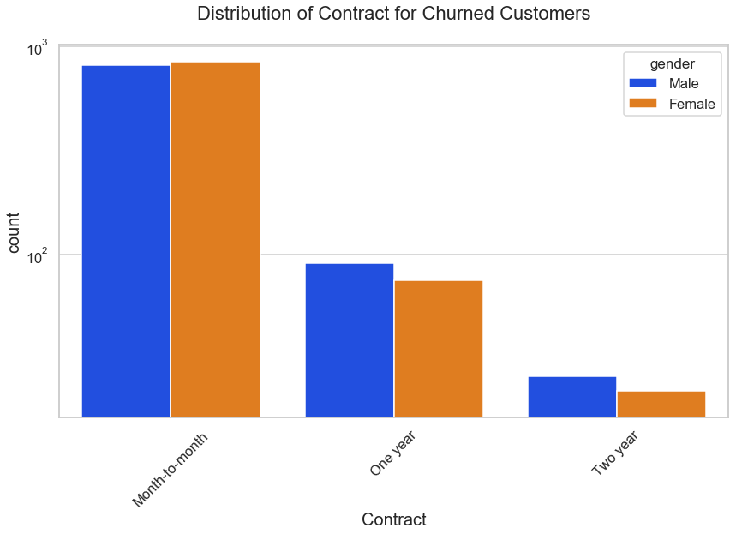
Customers who use certain payment methods may be more likely to churn than others.
Customers with month-to-month contracts are more likely to churn compared to those with one-year or two-year contracts.

Slide 9
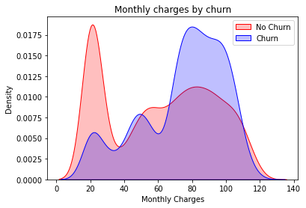
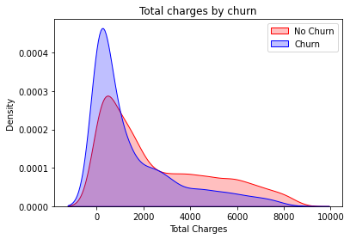
Churn by Monthly Charges and Total Charges

Slide 10

Thank you

